Slide 1


Smart weather (without jira)
Hemanth kumar reddy Edde

Slide 2
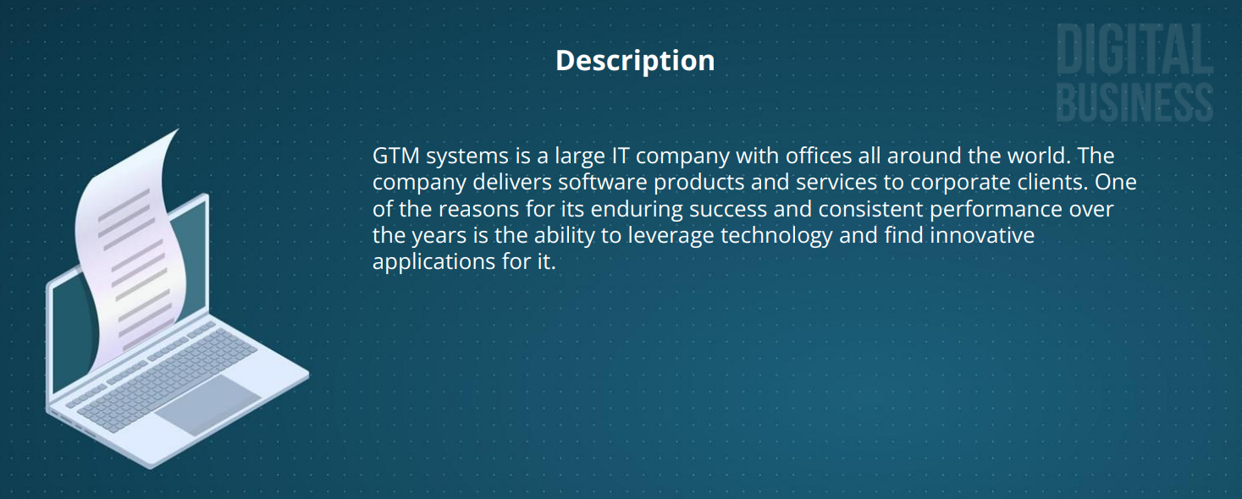

Slide 3
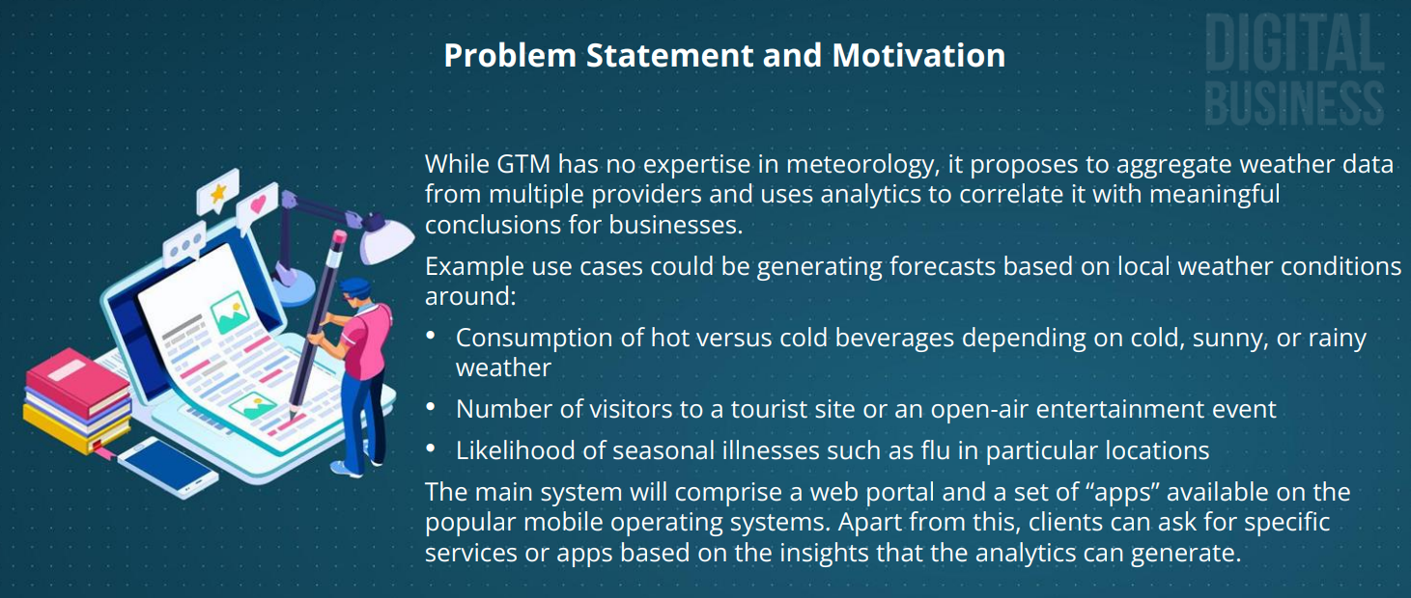

Slide 4
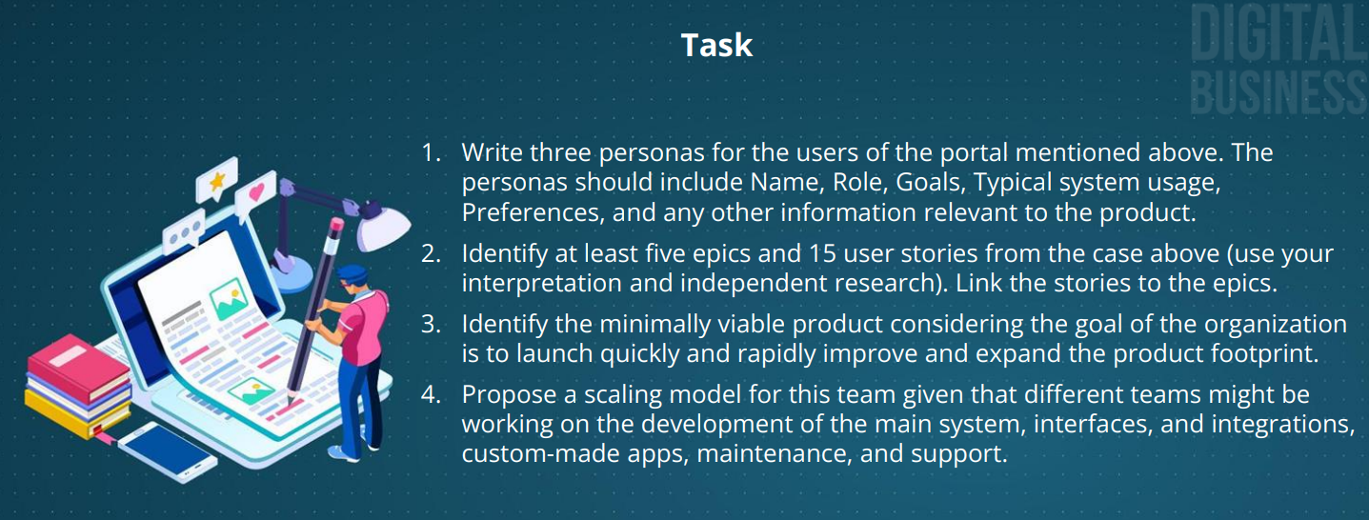

Slide 5
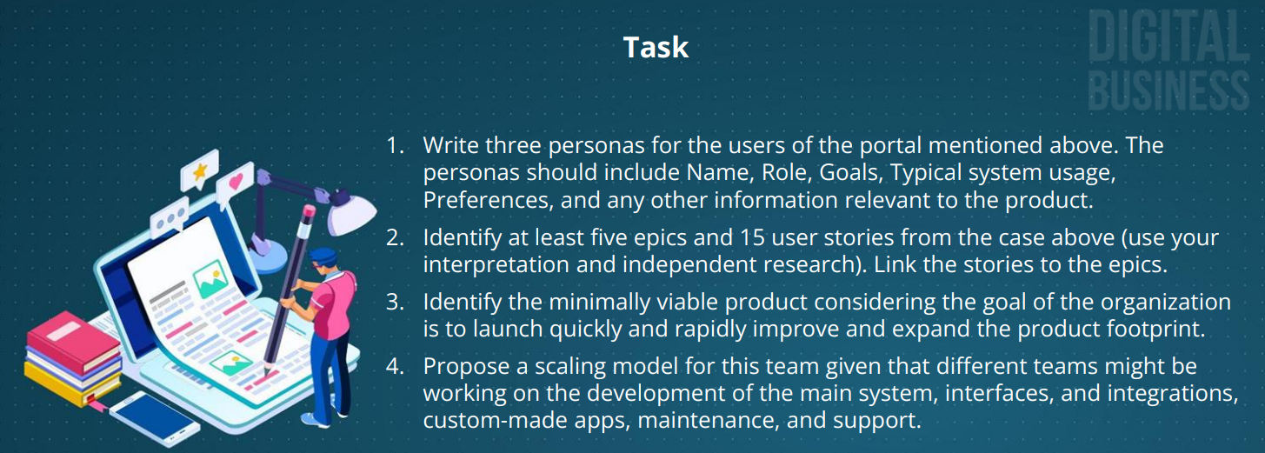

Slide 6
Task-1
Three personas for the users of the portal mentioned above. The personas should include: Name,Role, Goals,Typical system usage,Preferences,and
1- As a canteen owner, I would like to know when it is the best market a cold or hot beverages to my customers to increase my revenue for the day
2- As a news reporter I want to be updated on weather condition across the world’s
3- As a Provisional store owner, I want to see weather conditions on my phone to decide on the products I should stock in my shop
Task-2
3 personas and 5 user stories for each

Slide 7
Epic-1 | User Stories →1-5
As a canteen owner, I would like to know when it is to best market a cold or hot beverages to my customers to increase my revenue for the day | I want to see the historical weather forecast & actuals of my location that will help me decide which product is host to market for each coacon | Create a schema and a database for storing weather data based on location
 | I also want an app that I can use to market my products without purchasing a separate tool for weather forecasting and saves me money and increase profitability | Have provisions for advertisements on the portal and Apps
 | I want to see the seasonal forecast with information such as how hot/cold will be the day/week/month | Provide seasonal forecasts like seasonal precipitation and temperatures
 | I want to have the accessibility of the services I paid whenever & wherever I need to either through mobile or computer | Access control for paid services
 | I want an application that I can share to my customers for free where they can also see my advertisements and increase my market & profitability | Enable registration for free and paid users

Slide 8
Epic-2 | User Stories→1-5
As a news report, I want to have an access to a relevant application either thru mobile or a computer that will give me accurate gather conditions across the world, with images | I want to see the weather conditions of every country and major cities across the world | Build integrations with public weather services
 | I want to see the reports across multiple agencies and validate accuracy of reports I will be sharing to my news | Build logic to reconcile and aggregate data from multiple service providers
 | I want to share satellite images from major continent to country and to major city view | Show satellite images
 | I want to see and share the forecast timeline by day, by week, from land of storm to departure to each city | Show time-lapse videos of satellite forecasts
 | I want to have access to the portal from devices such as mobile, laptop, personal computer and android TVs | Publish API or Services for client apps
Have provisions for advertisements on the portal and
Apps

Slide 9
Epic-3 | User Stories →1-5
As a Provisional store owner, I want to see weather conditions on my phone to decide on the products that I should stock in my shop | I want to access it through my android or IPhone since my employees may also need it | Create apps for iOS and Android phones Show current weather at a location
 | - I want to have real time status of current weather at a location where I am so I can plan accordingly and close shop when needed | Detect locations based on GPS (if on a device) or IP
 | I want to see the weather forecast ahead of time to ensure that I can stock my supplies accordingly | Show forecasts for five, ten, and fifteen days at a location
 | I want to be alerted about inclement weather so that I can close shop and ensure safety of my employees | Provide severe weather advisory to registered users on the portal
 | I want an application that will allow me to have full access of the services I paid regardless of the time or place I use it | Access control for paid services
Build logic to reconcile and aggregate data from multiple service providers
Have provisions for advertisements on the portal and
Apps

Slide 10
These Highlighted are the minimally viable product considering the goal of the organization is to launch quickly and rapidly improve and expand the product footprint
To do list for Sprint
1. Enable registration for free and paid users
2. Build integrations with public weather services around the world
3. Det locations based on GPS (if on a device) or IP
4. Create a schema and a database for storing weather data based on location
5. Build logic to reconcile and aggregate data from multiple service providers
6. Access control for paid services
7. Provide severe weather advisory to registered users on the portal
8. Have provisions for advertisements on the portal and apps
9. Show current weather at a location
10. Show forecasts for five, ten, and fifteen days at a location
11. Provide seasonal forecasts like seasonal precipitation and temperatures
12. Show satellite images
13. Show time-lapse videos of satellite forecasts
14. Make a responsive design for the portal (usable for different devices and form factors)
15. Publish API or Services for client apps
16. Create apps for iOS and Android phones

Slide 11
High
1,3,7,9,10,16
Ideal for MVP
Potential customer Impact
Low
Ease of Implementation
High

Slide 12
Propose a scaling model for this team given that different teams might be working on the development of the main system, interfaces, and integrations, custom-made apps, maintenance, and support
Definition of “Completed Product” | TO-DO | Build | Test | Review | Release Team Plan | Scrum Team Owner
An Android o iOS application that enables registered users to view current and forecasted weather fo their location and advises them about it's inclemency | Create apps for iOS and Android phones | Week 1-2 | Week 3 | Week 4 | Week 4 | Scrum Team 1
 | Enable registration for free and paid users | Week 1-2 | Week 3 | Week 4 | Week 4 | Scrum Team 1
 | Show current weather at a location | Week 1-2 | Week 3 | Week 4 | Week 4 | Scrum Team 1
 | Show forecasts for five, ten, and fifteen days at a location | Week 1-3 | Week 4 | Week 5 | Week 5 | Scrum Team 2
 | Show forecasts for five, ten, and fifteen days at a location Detect locations based on GPS (if on a device) or IP | Week 1-3 | Week 4 | Week 5 | Week 5 | Scrum Team 2
 | Provide severe weather advisory to registered users on the portal | Week 1-3 | Week 4 | Week 5 | Week 5 | Scrum Team 2
Scrum Team 1 | Composed of 4 members specializing with mobile phone software development both on iOS and Android
Scrum Team 2 | Composed of 4 members specializing with software development and data analytics

Slide 13
